Slide 1
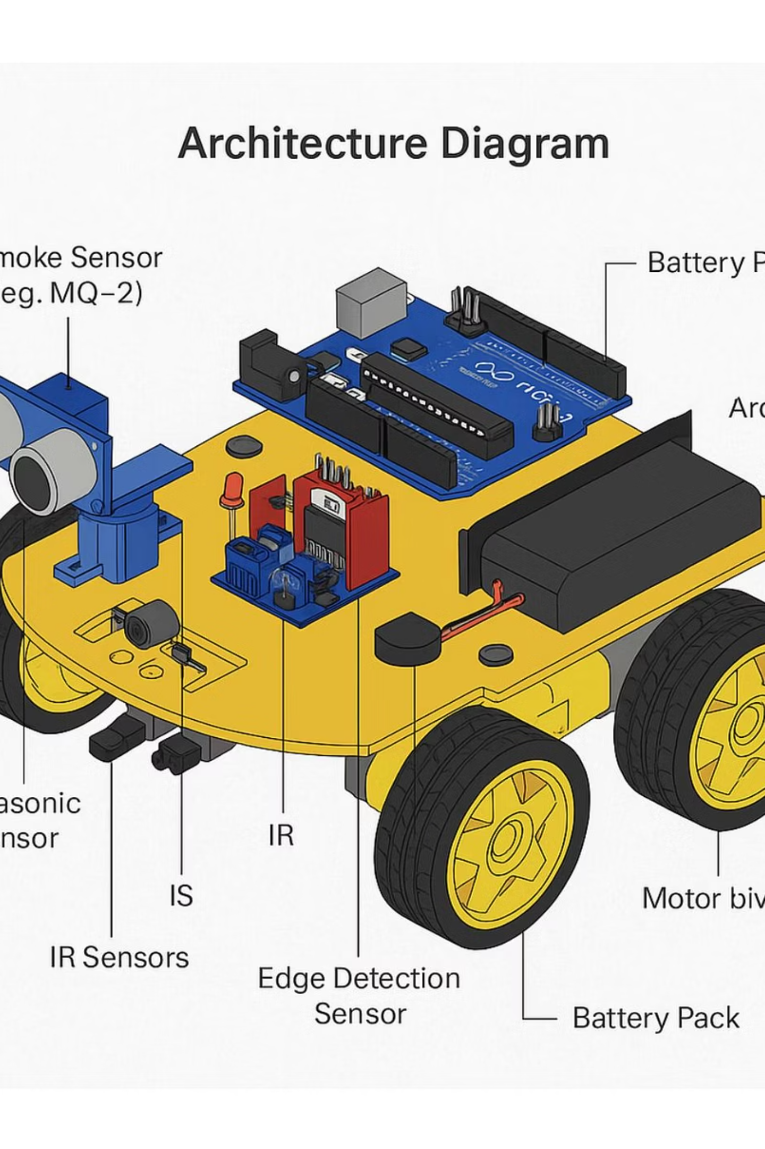
PathPal: A Human Following Robot Using Sensors
This Arduino-powered robot follows children or elderly people, detects smoke, gas, or edge hazards, and provides real-time alerts via buzzer and LED for enhanced safety.

Slide 2

Group Members
Bharath G
CB.SC.U4CSE24005
Dhanusri AP
CB.SC.U4CSE24011
Kesikasri S
CB.SC.U4CSE24023
Vishal Teja
CB.SC.U4CSE24052

Slide 3

Project Overview
Core Functionality
Safety Features
Uses ultrasonic sensors to detect and follow a person at a safe distance. Equipped with MQ-2 smoke sensor for fire hazards, gas leaks, and smoky areas.
IR sensors detect edges like stairs or cliffs. Activates buzzer and LED for immediate alerts on dangers, blending robotics, sensors, and safety systems.

Slide 4




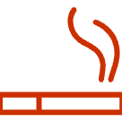
Hardware Requirements
Arduino Uno
Ultrasonic Sensor (HC-SR04)
Main microcontroller board.
For measuring distance from human and obstacle detection.
IR Sensors
Smoke Sensor (MQ-2)
For human direction tracking and basic obstacle detection.
For detecting smoke or harmful gases.

Slide 5
More Hardware Components
01
02
03
Motor Driver (L298N)
DC Motors with Wheels
Edge Detection Sensor
Controls direction and speed of DC motors.
For robot movement.
IR or light sensors facing downward to detect edges.
04
05
Buzzer & Red LED
Battery Pack & Chassis
For emergency alerts; servo motor optional for scanning.
7.4V or 12V power supply; body for mounting components.

Slide 6

Software Requirements
Arduino IDE: Write, compile, and upload code to Arduino Uno.
Libraries: NewPing for ultrasonic; Servo.h for servo; MQ2.h for smoke; IRremote for IR/edge.
Tinkercad Circuits: Simulate electronics, sensor inputs, and code.
CH340/CP210x Driver: USB-to-serial for uploading to clones.
Design Tools: TinkerCAD 3D/Fusion 360 for architecture; image tools for diagrams.

Slide 7
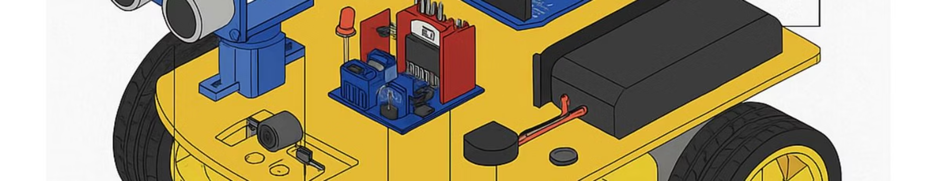
Architecture Overview
The robot integrates sensors for following, detection, and alerts in a cohesive system.

Slide 8



Expected Outcomes
For Children
Mobile guardian follows at safe distance, detects smoke/gas with MQ-2, alerts via buzzer/LED on edges like stairs to prevent falls.
For Elderly
Smart companion scans ahead for dangers, warns on smoke, gas, or edges; enhances independence and safety indoors.

Slide 9
Project Results
1
1. Following Mechanism
Ultrasonic sensors enable successful person following at secure distance.
2
2. Edge Detection
IR system prevents falls from ledges, table edges, stairs.
3
3. Smoke/Gas Detection
MQ-2 simulates emergencies by identifying gas or smoke.
4
4. Alerts
Buzzer and red LED activate on dangers for visual/auditory warnings.
5
5. Integration
All components function in unison as a safety assistant.

Slide 10

Applications & Conclusion
Key Applications
Conclusion
Elderly Care: Follows and warns on gas leaks or falls.
PathPal combines ultrasonic following, MQ-2 detection, IR edges, and alerts into a low-cost safety assistant for homes, schools, elder care—proving basic tech protects vulnerable people.
Child Safety: Monitors kids, detects smoke or fall risks in homes.
Home Automation: Mobile patrols in smart systems.
Future: Disaster response bots in smoke-filled areas.
Enhancing safety through innovative robotics.

